Slide 1


From insights to action, the path to extraordinary value starts here.

Slide 2


Be future-ready now
66%
If the last 18 months has taught us anything, it’s that change happens fast.
Operations goals need to be realized more quickly than ever to help the business keep pace. Our latest research modelling has discovered a multiplier effect which can fast-track operations to future-ready performance.
of organizations risk failing to achieve “future-ready” outcomes in the next three years.
Manish Sharma
Group Chief Executive, Accenture Operations
2

Slide 3

No one-size-fits-all
It’s important to tailor any intelligent operations journey.
Earlier research identified four levels of operations maturity
—stable, efficient, predictive and future-ready—based on our respondents’ assessments of eight characteristics.
For simplicity we grouped those eight characteristics into four levers:
Technology
Process
Data
Talent
Adjusting these levers can accelerate organizations’ progress toward future-ready performance.
The Value Multiplier

Slide 4
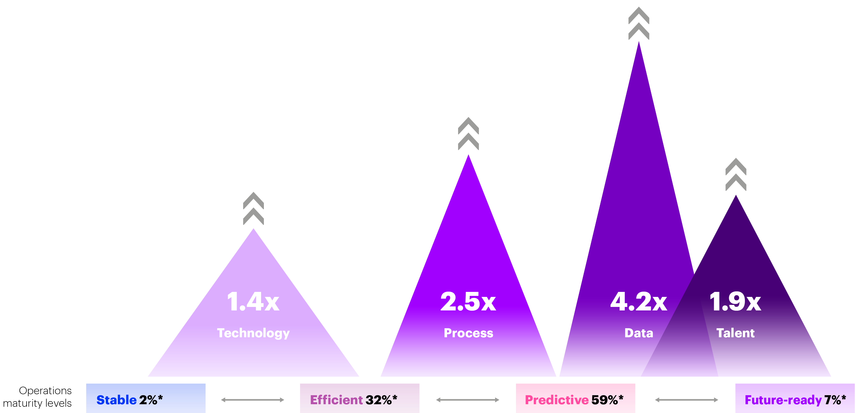
The peak multiplier impact of applying each of the four levers to reach future-ready operations maturity.
Apart from greater productivity and efficiency, future-ready organizations are ahead of the game when it comes to improvements in many areas that make a material difference to business success.
operations
maturity levels

Slide 5

There’s a significant boost in key business areas from moving to future-ready.
Value
Innovation
Talent
1.5X
1.5X
1.8X
boost in business value generated from data by moving from stable or efficient to future-ready.
boost in speed of product
and service innovation by
moving from stable or
efficient to future-ready.
boost in employee engagement and retention by moving from stable or efficient to future-ready.
The Value Multiplier
Copyright © 2022 Accenture. All rights reserved.
5

Slide 6

By applying all four levers in an integrated manner, organizations can double their chances of becoming future-ready.
14.2X
1.2X
boost in moving up one maturity level when all four levers are applied
in an integrated manner.
boost in overall profitability by making that step.
Operational change
isn’t a one-and-done event.
Copyright © 2022 Accenture. All rights reserved.
6

Slide 7

How to get there
Let’s take a closer look at how moving the different levers—technology, process, data and talent—can affect organizations’ operational maturity.
The Value Multiplier
Copyright © 2022 Accenture. All rights reserved.
7

Slide 8
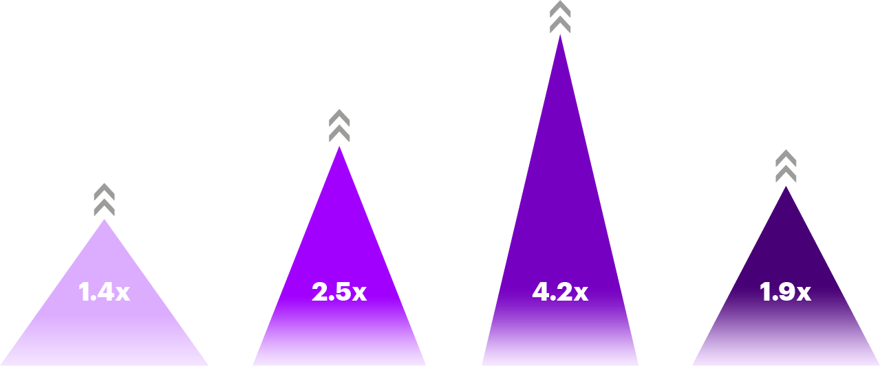
The technology lever
Includes: the role of automation, the adoption of new technology solutions and collaboration between business functions and IT.
What happens when organizations move the technology lever?
1.3X
90%
Technology
more likely for predictive and future-ready organizations than stable or efficient to see automation, including human+machine interactions, as having a positive impact on their ability to respond to crises, such as COVID-19.
of future-ready organizations favor applying cloud at scale, compared with 76% of the rest.
more likely to make the leap from stable to efficient operations maturity through improving technology capabilities, with the greatest impact at the beginning of the operations maturity journey.

Slide 9
The process lever
Includes: the application of leading practices and benchmarking and the implementation of customer, employee and business partner experience initiatives.
What happens when organizations move the process lever?
40%
more likely to make the leap from efficient to predictive operations maturity through improving their process capabilities—the highest leap of all the different levers at the midpoint maturity level.
of organizations expect customer, employee and partner experience management strategies to be in use at scale in the next three years.
Process

Slide 10
The data lever
Includes: the application of data, analytics and artificial intelligence to enhance business performance and stakeholder experiences.
What happens when organizations move the data lever?
1.3X
71%
more likely to make the leap from predictive to future-ready operations maturity and 2.5X from stable to efficient through improving their data capabilities.
of predictive and future-ready organizations are more likely to design their operating model based on data.
of future-ready organizations prioritize data over intuition when designing their operating models, compared with 54% of stable or efficient organizations.
71%
of future-ready organizations emphasize data science and AI compared with 50% of stable, efficient and predictive organizations.
Data

Slide 11
The talent lever
Includes: the role of workforce strategies, the use of both human skills and machine capabilities and the ability to use specialized talent or broader talent ecosystems.
What happens when organizations move the talent lever?
1.2X
more likely to make the leap from predictive to future-ready operations maturity through improving their talent capabilities.
of future-ready organizations are more likely to have seen improved performance in employee talent mix and reskilling, compared with the other maturity categories in the past three years.
Talent

Slide 12

A global insurance firm transformed procurement and finance to not only be more data-driven, automated and digital—increasing cash flow by US$300M in just one year—but also create an environment in which its employees could work smarter, scale faster and be more productive.
Source: Data-driven operations improve cash flow by $300M, Accenture
The Value Multiplier
Copyright © 2022 Accenture. All rights reserved.
12

Slide 13
Take these intentional, strategic steps that act as a multiplier for operations maturity.
Here’s how you can move up from:
Predictive to Future-ready
Efficient to Predictive
Implement integrated solutions using automation, analytics and AI, reimagine processes, use diverse data and scale data science, and AI and embed specialized talent.
Stable to Efficient
Enhance automation, measure and manage experience, apply advanced analytics and develop a talent marketplace for
on-demand collaboration.
Develop a governance model and business-IT roadmaps, benchmark processes and outcomes, adopt a data culture and augment humans with machines.

Slide 14


Meet the authors
Manish Sharma
Group Chief Executive,
Accenture Operations
manish.sharma@accenture.com
Kaushal Mody
Growth and Strategy Lead,
Accenture Operations
kaushal.m.mody@accenture.com
Manish Sharma is group chief executive of operations services and a member of the Accenture Global Management Committee. He leads a team of more than 170,000 professionals providing a portfolio of business process services for specific business functions, including finance, procurement and supply chain, marketing and sales, as well as industry-specific services, such as banking, insurance and health services.
Kaushal Mody is a global business leader in Accenture Operations and member of the Accenture Global Leadership Council. He has around 25 years of experience in consulting, transformation and intelligent operations across multiple industry sectors. He acts as a strategic advisor to several Fortune 500 clients. His work focuses on acquisitions, alliances and strategic investments.

Slide 15
Appendix
Survey demographics
Four levels of operational maturity:
1,100
Stable
Concentrate mostly on core process improvements
and on improving quality and compliance controls.
Efficient
More productive, they incorporate tested methods,
such as Lean Six Sigma and process standardization
and deploy automation technologies.
Predictive
Focus on how automation can support and augment human ingenuity. They deploy technologies and leading practices with that goal in mind.
Future-ready
See increased efficiency and profitability, improved stakeholder experiences and better business outcomes. They are more agile and resilient than others.
executives
13
industries
Automotive
Banking
Communications
Consumer Goods
& Services
Health
High Tech
Industrial Equipment
Insurance
Life Sciences – Biopharma
Media
Oil & Gas
Retail
Travel
11
countries
Australia
Brazil
Canada
China
France
Germany
Italy
Japan
Spain
United Kingdom
United States

Slide 16
We defined the four levels of operations maturity based on respondents’ assessments of eight characteristics and then consolidated these characteristics into four levers as follows:
The technology lever includes the role of automation and collaboration between business functions and IT in making the best use of technologies. Automation involves sets of technologies that perform repetitive rule-based tasks. Robotic process automation (RPA), one of the most frequently used examples, increasingly includes multiple solutions such as workflows, platforms and software-as-a-service that further digitalize the process. Business-technology collaboration comprises IT and business functions with joint governance models, enabling integrated ecosystems partners and driving the organization’s strategic road map.
The process lever includes the implementation of customer, employee and business partner experience initiatives and leading practices. Functional and industry leading practices are ways of doing business within a function, organization or industry that are recognized as enabling best-in-class performance. Stakeholder experiences include the overall engagement experience across all stakeholders of an enterprise including customers, end-clients, suppliers, partners and employees.
The data lever includes collection, storage, and application of data, the use of data insights or artificial intelligence. Data involves the quality, scope and depth of structured and unstructured (for example, video, web content, voice memos, etc) data from diverse internal and external sources, including what is embedded in internal processes. Analytics covers the discovery, interpretation and communication of meaningful patterns in data to provide superior insights for business decision making. Analytics includes multiple levels from basic descriptive reporting to more predictive and prescriptive actions which can be applied to business processes.
Artificial intelligence is the ability of a machine to perform cognitive functions like sensing, comprehending, acting and learning. AI capabilities for example, natural language processing, machine learning enable computers to make decisions and identify patterns and insights for future decision making.
The talent lever includes the role of workforce strategies, which can include internal skills development, the use of both human skills and machine capabilities and the ability to use broader talent networks. Workforce agility encompasses two key elements on-demand, collaborative workforce strategy and a work environment where humans and digital machines work together to drive the best outcomes.

Slide 17
About Accenture
Accenture is a global professional services company with leading capabilities in digital, cloud and security. Combining unmatched experience and specialized skills across more than 40 industries, we offer Strategy and Consulting, Interactive, Technology and Operations services—all powered by the world’s largest network of Advanced Technology and Intelligent Operations centers. Our 624,000 people deliver on the promise of technology and human ingenuity every day, serving clients in more than 120 countries. We embrace the power of change to create value and shared success for our clients, people, shareholders, partners and communities.
Visit us at www.accenture.com.
About Accenture Research
Accenture Research shapes trends and creates data driven insights about the most pressing issues global organizations face. Combining the power of innovative research techniques with a deep understanding of our clients’ industries, our team of 300 researchers and analysts spans 20 countries and publishes hundreds of reports, articles and points of view every year. Our thought-provoking research—supported by proprietary data and partnerships with leading organizations, such as MIT and Harvard—guides our innovations and allows us to transform theories and fresh ideas into real-world solutions for our clients.
For more information, visit www.accenture.com/research.
Copyright © 2022 Accenture.
All rights reserved.
Accenture and its logo are
registered trademarks of Accenture.
This document refers to marks owned by third parties. All such third-party marks are the property of their respective owners.
No sponsorship, endorsement or approval of this content by the owners of such marks is intended, expressed or implied.
This content is provided for general information purposes and is not intended to be used in place of consultation with our professional advisors.

